Slide 1


Valley Clean Energy Community Advisory Committee
Tuesday, November 12, 2019
VCE Administrative Offices, Davis

Slide 2
Item 7 - 2021 Short-Term Procurement Planning
2020 Procurement Plan
Board approval in December
Apply primarily to 2021 short term procurements
2021 clean power mix targets
  Short-Term renewables
  Large Hydro

Slide 3
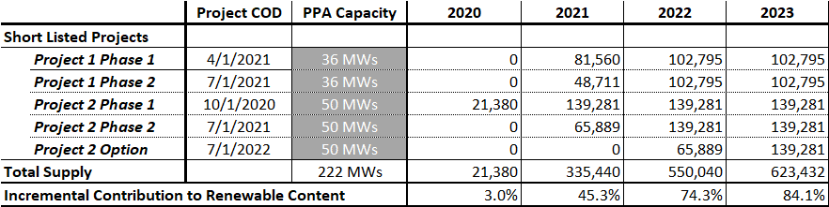
Item 7 - 2021 Short-Term Procurement Planning
Anticipated Long Term Renewables

Slide 4
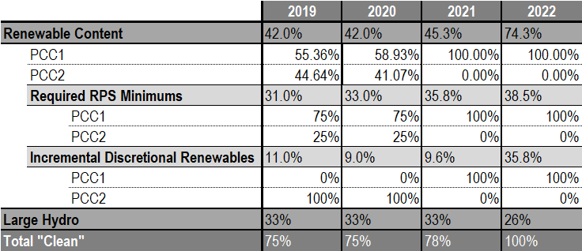
Item 7 - 2021 Short-Term Procurement Planning
Power Mix with Long Term Renewables

Slide 5
Item 7 - 2021 Short-Term Procurement Planning
Proposed Recommendations to Board
Rec 1 - Renewables
  No initial plan for short-term renewable procurements
  Only if it looks like deliveries from new long-term PPAs would fall below 42%
  Replace only with short-term PCC1 power
Rec 2 – Large Hydro
  Procure for 33% large hydro content to keep portfolio at least 75% clean.

Slide 6
Item 7 - 2021 Short-Term Procurement Planning
Recommendation to CAC
Support staff’s recommendation for 2021 renewable and large hydro procurement.

Slide 7
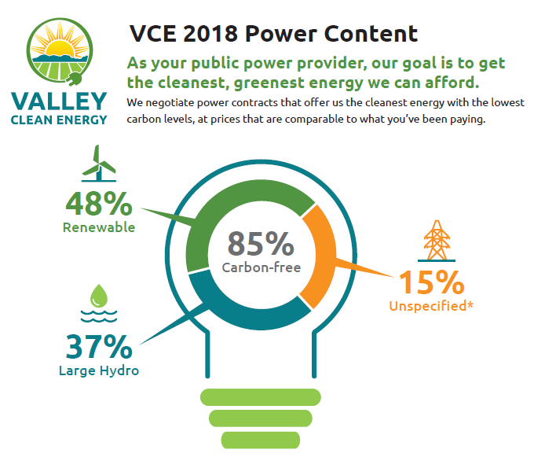
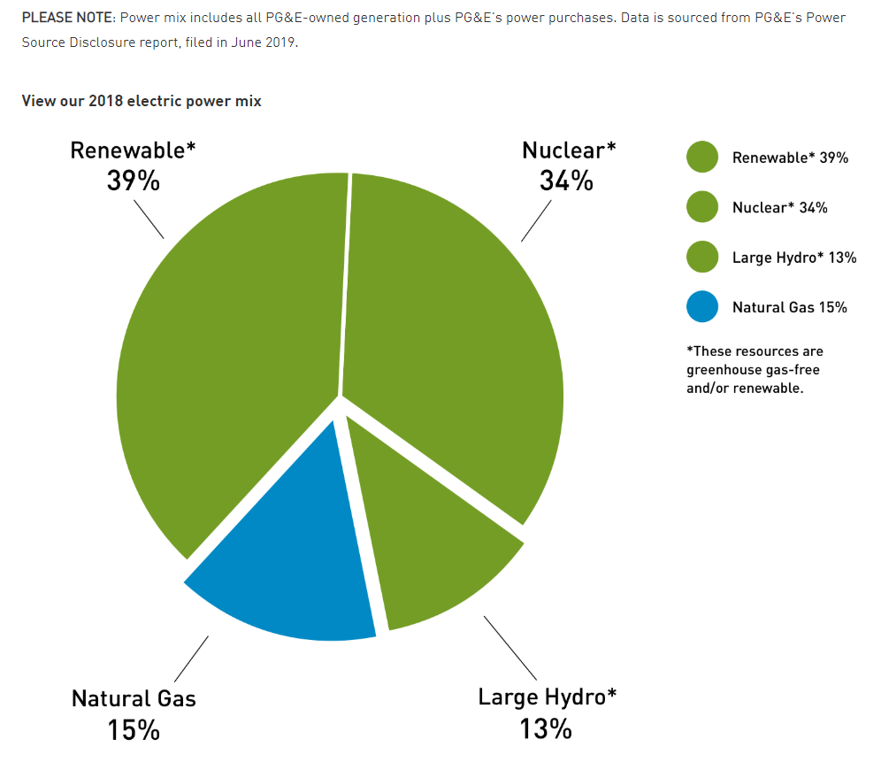

Reference Slides
Reference Slides
PG&E – 2018 Power Content

Slide 8
Item 8 - 2020 Integrated Resource Plan Update
CAC Meeting, November 12, 2019
VCE’s Administrative Offices, Davis

Slide 9
Item 8 - 2020 Integrated Resource Plan
Approximate timing | Activity
August 16, 2019 | 2018 Preferred System Plan LSE Progress Status Data Request Due
September 20, 2019 | CPUC staff release proposed data and requirements for 2020 filing
October 8, 2019 | CPUC release of preliminary RESOLVE Reference System Portfolio
November 6, 2019 | CPUC formal release of Reference System Plan
November 7, 2019 | CPUC Final IRP Procurement Decision
December 9, 2019 | IRP Workshop (Stakeholder meeting)
December, 2019 | Proposed Decision Released on Reference System Plan
December, 2019 | Final templates, tools, and filing instructions released
February, 2020 | Commission Decision on Reference System Plan
February, 2020 | Draft IRP ready / CAC & Public Review
March, 2020 | VCE Board discussion and feedback on draft IRP & CAC Recommendations
April, 2020 | VCE Board Adoption of IRP
May 1, 2020 | CPUC IRP Filing Due
Notes:
Activities are getting under way for the CPUC required 2020 Integrated Resource Plan.
Filing is due May 1, 2020.
Templates and data requirements are under development by CPUC staff.
Informal feedback sessions between stakeholders and CPUC are taking place.

Slide 10
Item 8 - CPUC-Required IRP Features
(Based on CPUC Decision and IRP Template)
1-3 year action plan – needs to include procurement plan and update
Covers 2020-2030. Every year must be reported
At least one conforming portfolio based on 2019 IEPR Mid Demand Case
Report on GHG emissions and criteria pollutants of portfolio (including market purchases)
Report on impact on disadvantaged communities
Methodology explanation
Demonstrate compliance with PUC 454.52(a)(1), i.e. GHG, RPS, Just and reasonable rates, minimize ratepayer bills, reliability, diversity and sustainability, local pollution, distribution systems

Slide 11
Item 8 - Regulatory Developments Affecting the
Resource Plan
IRP Proceeding (R.16-02-007) decision on November 7 ordering procurement of 3,300 MW of incremental capacity and requesting delayed retirement of 3,750 MW of once-through-cooling (OTC) generating capacity located in SCE service territory
  VCE’s share of the 3,300 MW of incremental capacity is 12.8 MW
  SCE will procure “system capacity” which means costs may be shared through the cost allocation mechanism and will likely include costs and capacity credit for VCE
RPS Proceeding (R.18-07-003). Behind-the-meter solar PV to be modeled as a grid resource and assigned ELCC value of 0.1. ELCC values for wind and solar TBD but likely to go down significantly => more capacity must be procured to meet reliability requirements. IOUs are mandated to undertake ELCC studies and publish results by June 2020
Notes:
Other issues:
PCIA proceeding = no major changes other than how to ex-post true up resources and how to forecast PCIA for next 2(?) years)
RA Proceeding = no major changes but longer period of procurement ahead will be required and we may also see IOU procurement of capacity to secure sufficient and timely procurement
Necessity to use IEPR load forecast and “Mid-Mid” for EE means limited opportunities to consider issues such as GHG impact on load and load shape: demand programs; impacts of electrification

Slide 12
Item 8 - What has changed since August 2018?
CPUC order for 12.6 MW of new capacity for VCE by 2021 plus reporting on progress in early 2020 and in the IRP filing
60 Percent RPS by 2030
Must use 2019 IEPR load forecast. No scenarios on load variation
Covers 2020-2030. Every year must be reported
Improved GHG emissions calculator (still to be released)
Less new wind resources – based on load share VCE could expect to add only 20MW of new wind by 2030
Lower expected costs for energy storage and renewable energy

Slide 13
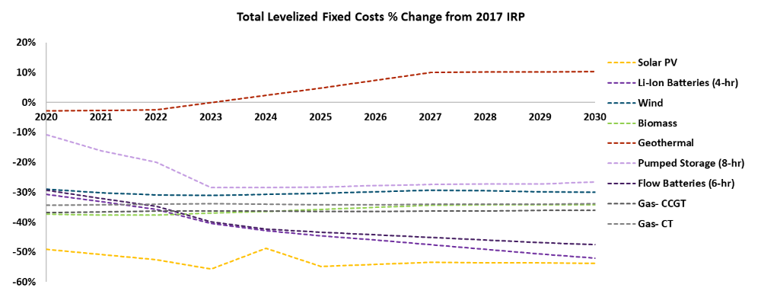
Item 8 - Change in costs for new resources
Source: CPUC, November 6, 2019 Reference System Plan Presentation (http://docs.cpuc.ca.gov/PublishedDocs/Efile/G000/M319/K128/319128759.PDF )

Slide 14
Item 8 - December IRP Workshop - Preliminary Agenda
Regulatory overview – requirements and latest developments
Timelines for completing the IRP and opportunities for public inputs
Tentative draft portfolios and costs based on latest available data from CPUC and load forecast
Resource costs and potential for new resources
Seek inputs on resource mix and desired actions with respect to resource procurement and GHG emissions

Slide 15
Item 8 - Potential Considerations for CAC and VCE
IRP resource scenarios to consider
2030 GHG goals and path to 2030
Programs – which ones, when and why?
Local resources roadmap– processes that could pave the way for increased local portfolio of renewables, DERs and demand measures, such as:
  Simplified or standardized permitting (identifying barriers and solutions)
  Identify potential locations
  Potential partnerships

Slide 16
Questions?

Slide 17


Item 9 – Update on development of potential VCE Electric Transportation program
November 12, 2019

Slide 18
Item 9 – Agenda
Background
Proposed Program
Next steps
Notes:
Last month, Dave Springer talked about CCAs that are getting IOU public goods funds and discussed two methods for obtaining funds.
Two CCAs—MCE and Lancaster successfully applied to the CPUC for funds—a long and onerous process\
There is another process to get funds that is less onerous, but has several strings attached.

Slide 19
Item 9 – Background
Staff presented program ideas to CAC at the July 25 meeting
Ideas included:
  Electrification--buildings
  Electric Transportation
  Load Shaping – storage, demand response
  Energy Efficiency

Slide 20
Item 9 – Background
Program design concepts—
  Leverage funding
  Coordination/Collaboration/Partnerships
  Education
  Low cost
  Grants

Slide 21
Item 9 – Background
CAC Direction—
  Rates and Services Task Group will focus program development efforts on local program options such as energy efficiency and electrification and exploring the possibility of VCE offering incentives for customers, especially NEM customers, to install energy storage.

Slide 22
Item 9 – Proposed Program
Implement an electric transportation program starting with a new ET webpage
Several options were considered—
  Develop our own content
  Link to another site without VCE branding
  Purchase content with VCE branding

Slide 23
Item 9 – Proposed Program
Platform | $ | Service | Pros | Cons | Target users | Comments
ChooseEV | $6400/yr. ($533/month) | - “cafeteria style” -See attached page for details | -Affordable -Branded with VCE -Data updated on a weekly basis -Customers would see VCE’s website as a reliable source of information -Keep users on our site -Flexible services (pick and choose features) VCE will be able to track site traffic | -Extra cost to add digital marketing -Cost involved compared to linking in source | Utilities, Sonoma Clean Power
ZappyRide Option 1 | Min. up front charge $39k + $2k/month to maintain | Create & maintain website | -Can be tailored to fit our needs -Quality information -One of the largest EV web providers | -Expensive - “Commercial” feeling (not appealing to customers & utilities) -Site “too constrictive” -Expects the site visitor to know a lot of info about EVs which they may not have -Difficult to navigate, awkward discovery phase to find basic information -Accused of delivering inaccurate, generalized carbon reduction info that may mislead viewers -Not branded with VCE logo | PG&E, Large utilities that want specialized content
ZappyRide Option 2 | Min. $2k/month | Provide info & updates, no site creation

Slide 24
Item 9 – Proposed Program
Enervee | $80k/yr. | Create website platform | -Engages ALL car shoppers & promotes benefits of EVs. -Proven to increase the share of EV buyers from less than 10% to 30%. -Different approach than other platforms (not a questionnaire) -36% of utilities customers bought an EV after visiting Enervee Cars -Tangible results | -Expensive -Non-negotiable digital marketing fees | Southern CA Edison, PG&E, Utilities | 8 weeks to start up
Link to PlugStar (uses ZappyRide platform) | $0 | -Shopping Assistant -Browse EVs -Find a Local Test Drive Event -Find an EV Dealer or Retailer -Need help feature | - No cost -Quality information -User friendly | -Does not keep VCE customers on our website - Unsure of citing obligations (will ask Green Ideals) | SMUD
Clean Technica | Phase II concept | Content producer that is sites and hosted on sites (PG&E example) | -Content wouldn’t have to be created -Wouldn’t be pointing customers away from VCE’s website -No ads on sidebars -Provide articles of EVs | -It’s a news service providing articles about EVs -Unsure about requirements for citing -Need to ask Green Ideals -Doesn’t help customers make an EV purchase decision | PG&E, News organization

Slide 25
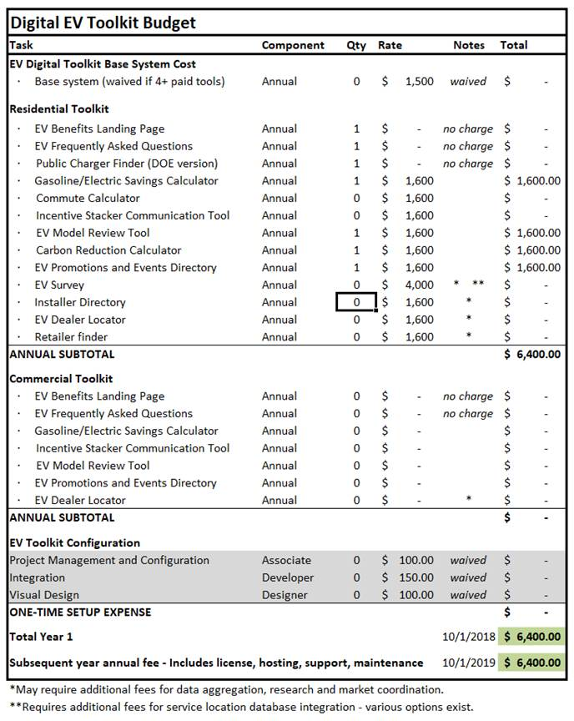
Item 9 – Preferred Choice--ChooseEV

Slide 26
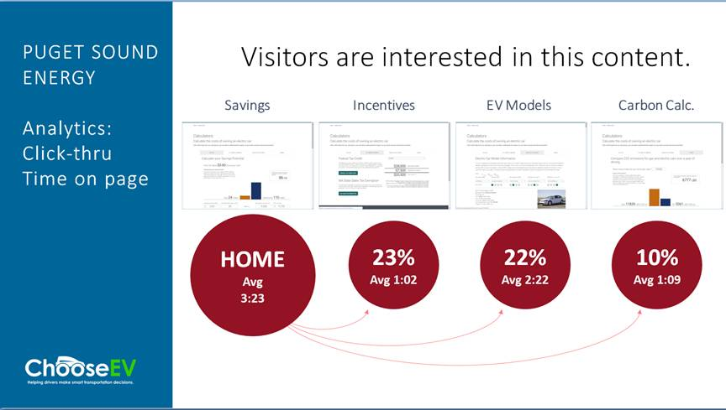
Item 9 – Preferred Choice--ChooseEV

Slide 27
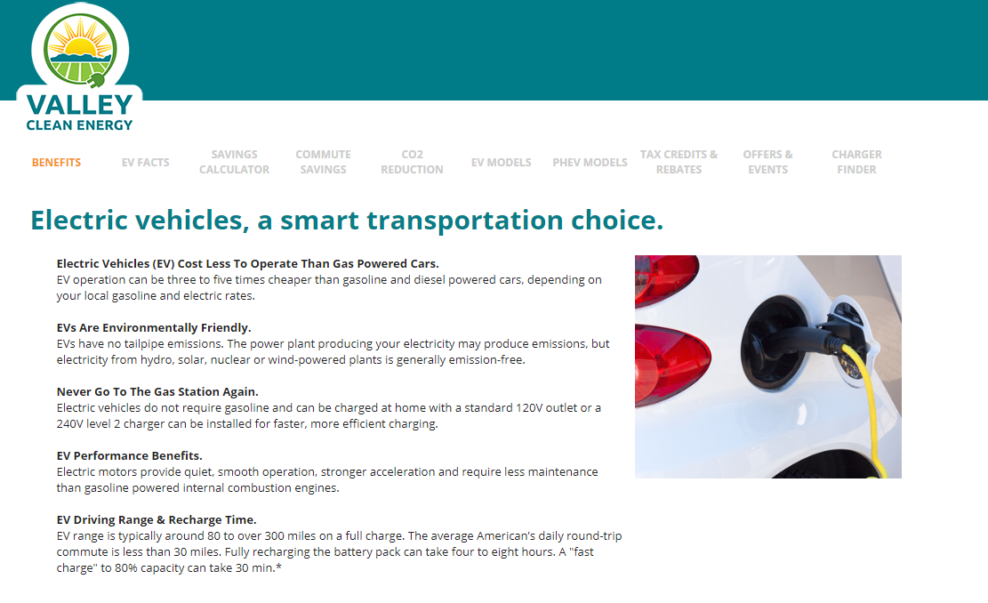
Item 9 – Preferred Choice--ChooseEV

Slide 28
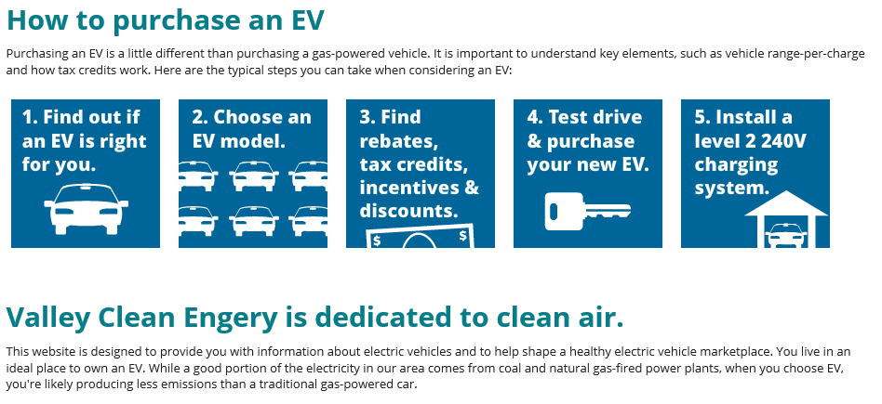
Item 9 – Preferred Choice--ChooseEV
Operable links—

Slide 29
Item 9 – Proposed Program
ChooseEV is the preferred choice to balance content, service, cost and branding
They provide ongoing updates, saving time and cost compared to developing our own content
They provide a menu of services allowing us to select the options that work best for us
They can implement the website quickly in coordination with Green Ideals – before year-end

Slide 30
Item 9 - Next Steps
Enhance Electric Transportation Program—
  Develop initiatives to drive traffic to the webpage
    Ride and drive events
    Coordination with other entities, e.g. Cool Davis, Sac EV
  Develop incentives
    Income qualified incentives
    Vehicle incentives
    Charging infrastructure incentives
    Look for grants

Slide 31
Item 9 - Next Steps
Develop 5-year program plan
  Building electrification
  Storage
  Energy efficiency
  Education
Include budgets, high-level goals and targets, etc.

